Slide 1
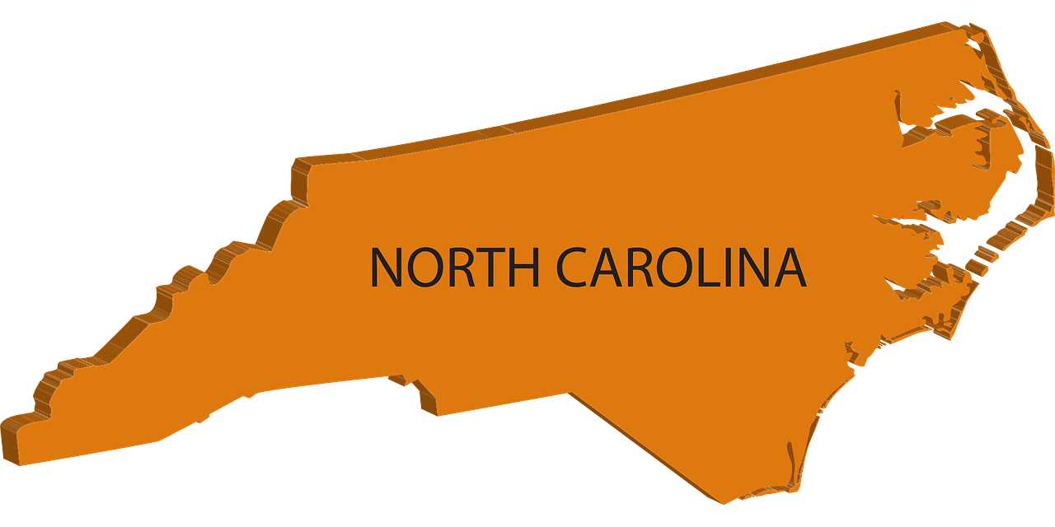
Human Migration
To, From, and Within North Carolina

Slide 2


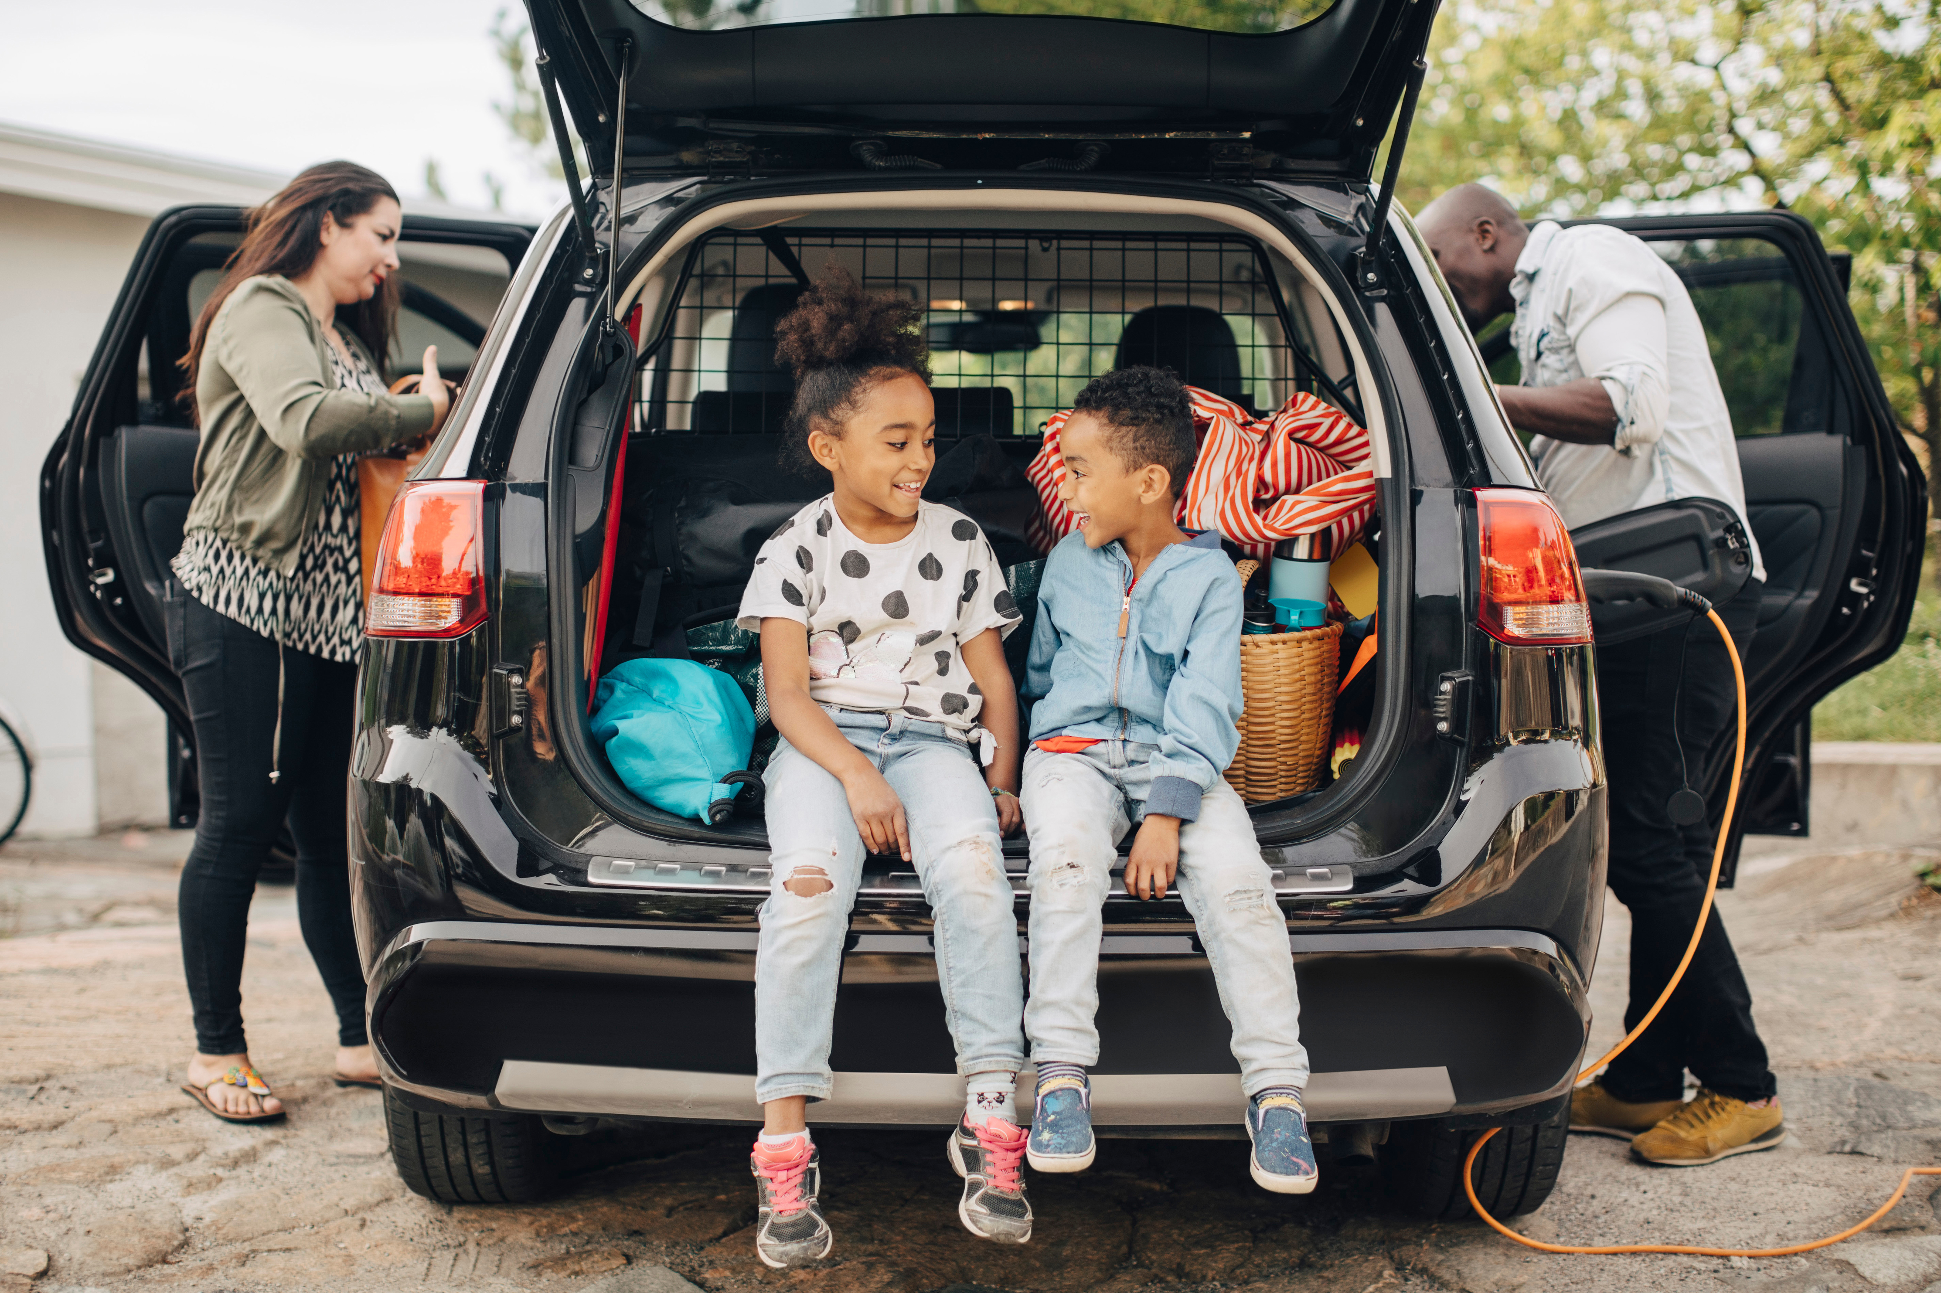
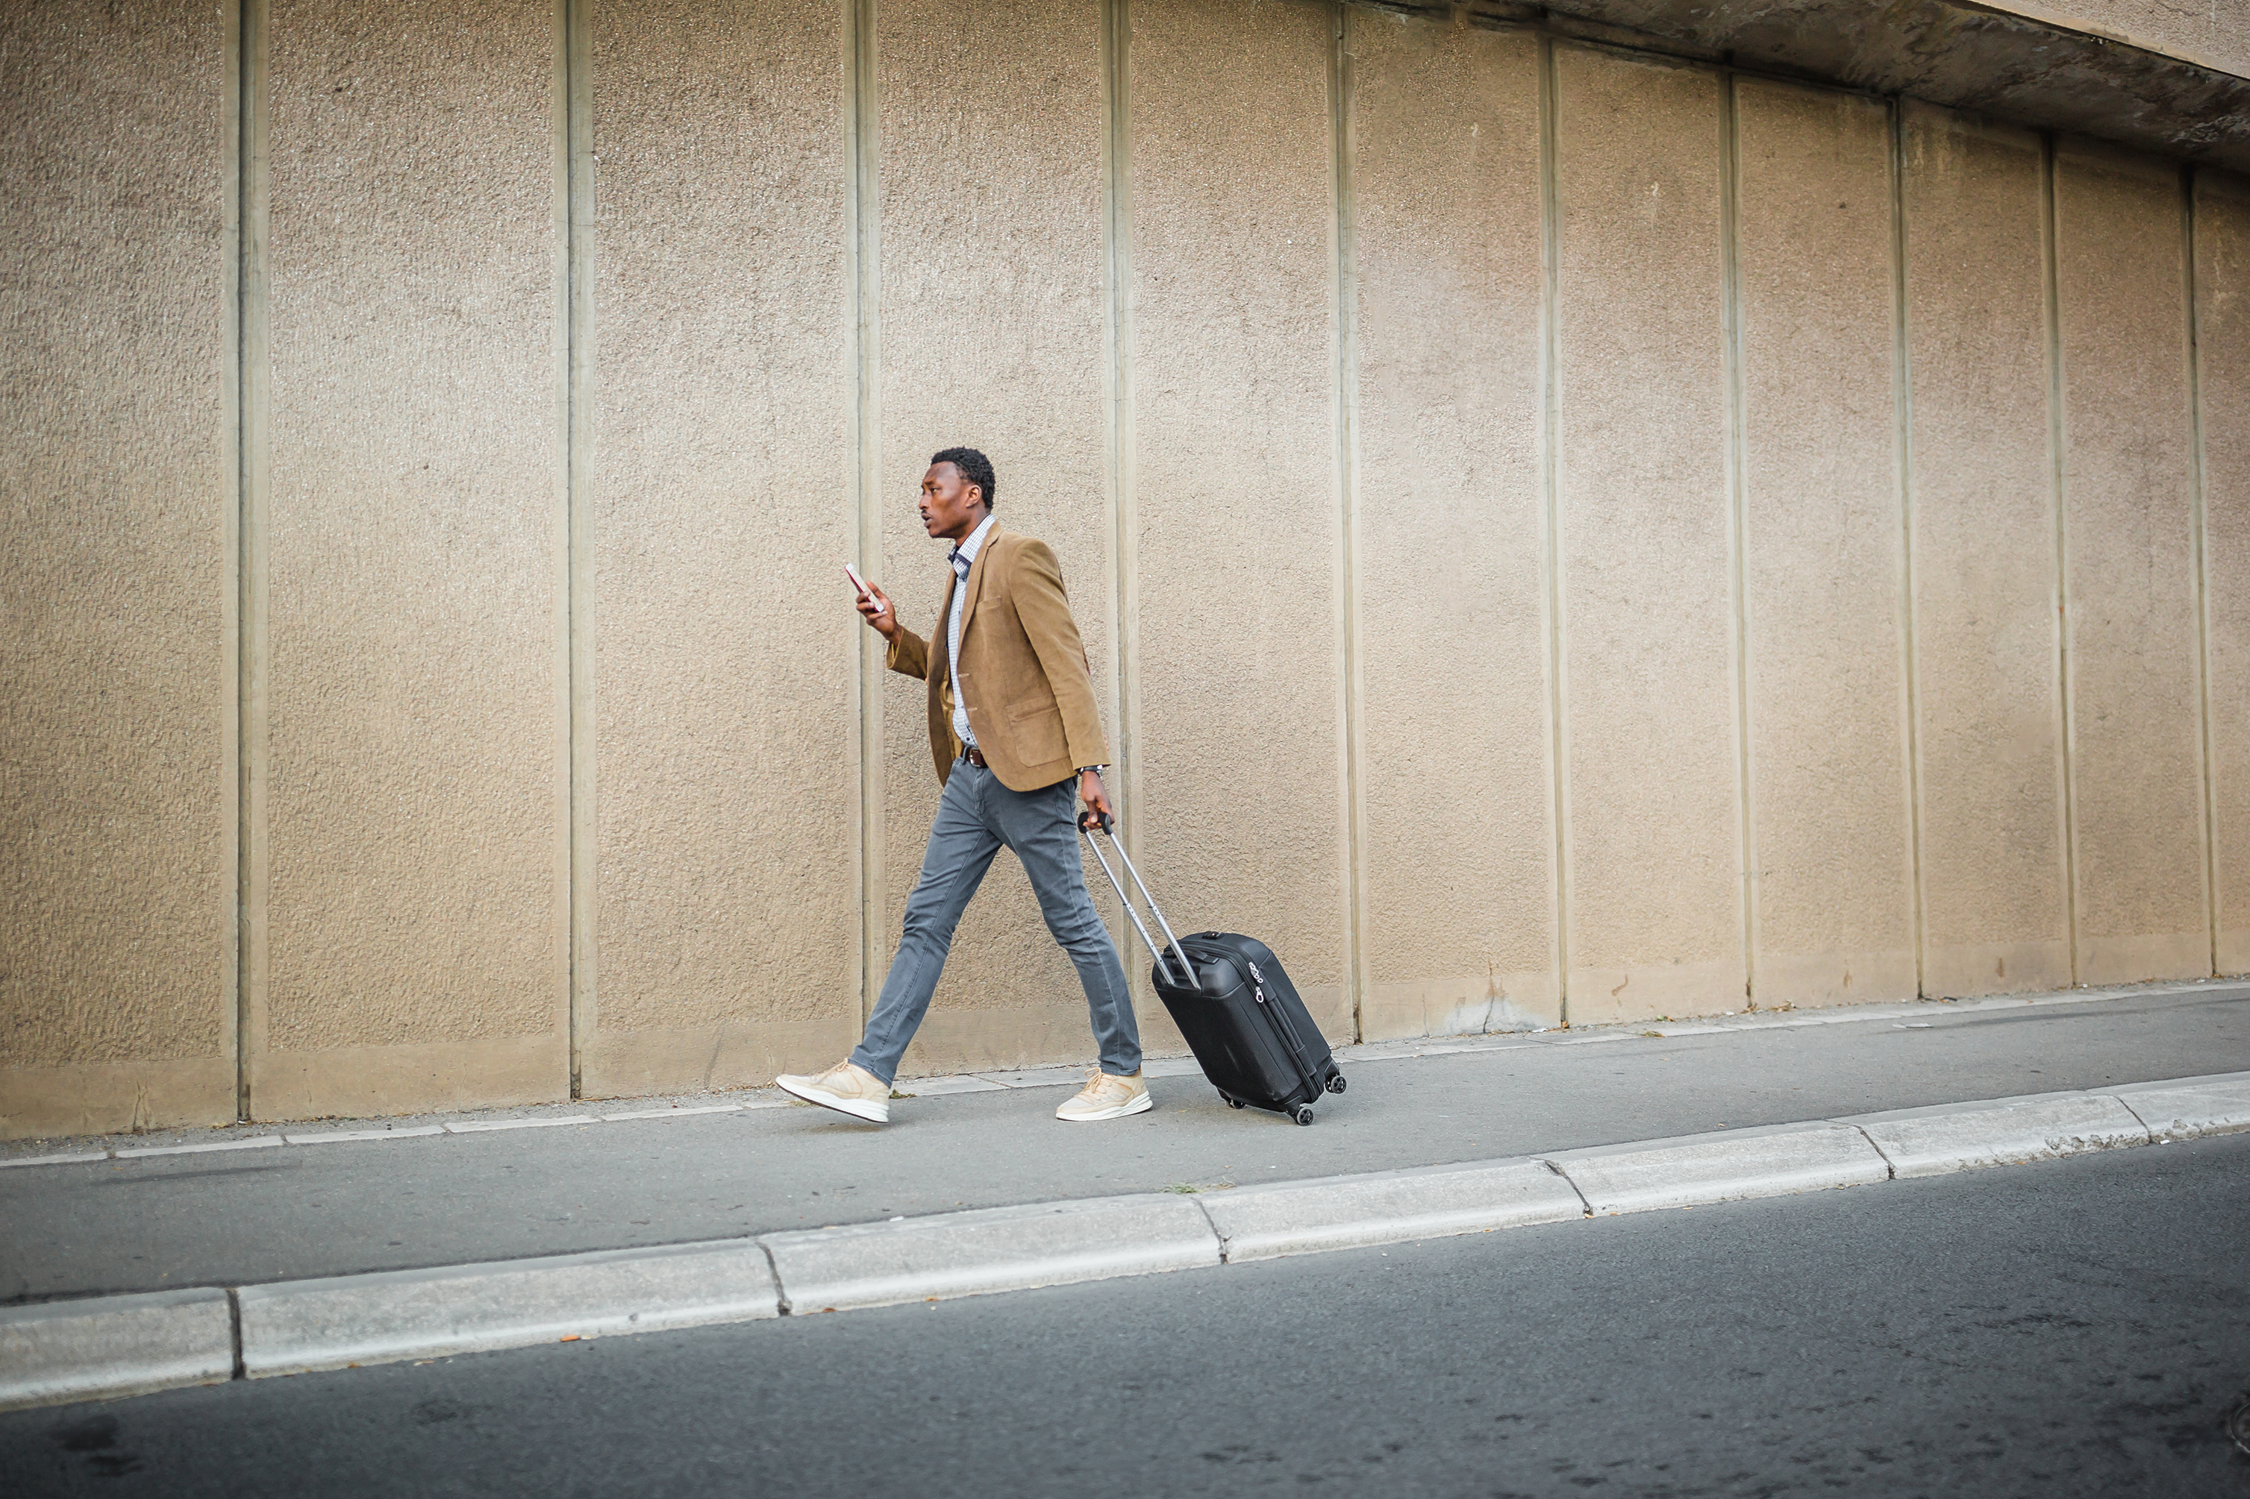
What is Human Migration?

Slide 3

Human Migration is...
The movement of people from one place to another with the intent to make it a permanent or temporary home.

Slide 4
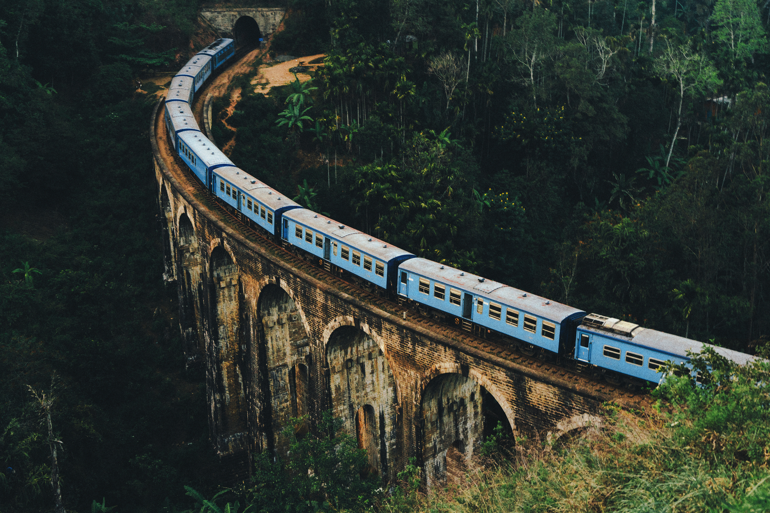

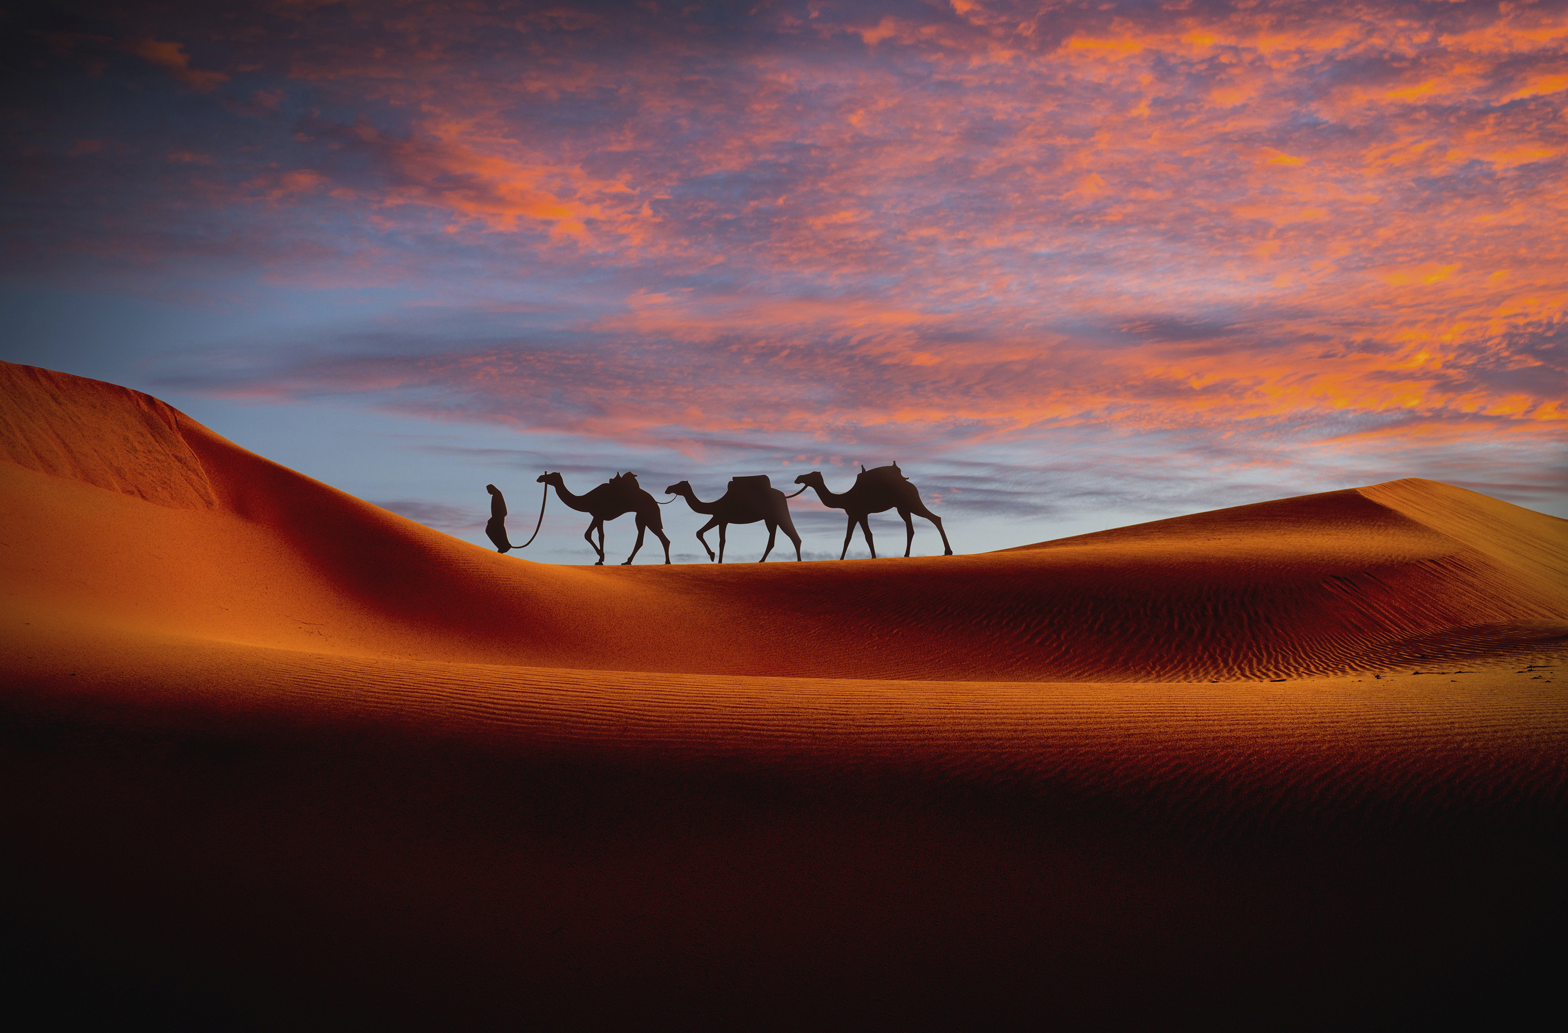

Four Types of Human Migration
Voluntary Migration
Forced Migration
Return Migration
Seasonal Migration

Slide 5

Voluntary Migration...
People making their own choice to move to another location.
Like retiring to the beach!

Slide 6
Voluntary Migration
In 1867 about 50 freed African Americans began a journey from Mississippi to Western North Carolina in hopes of establishing a better life focused on “one for all, and all for one” This became known as the Kingdom of the Happy Land.
Turn and Talk to a partner about how is this an example of Voluntary Migration.
Anne Whisnant and David Whisnant. Black Lives and Whitened Stories: From the Lowcountry to the Mountains. NPS. Carl Sandburg Home NHS. 2020 Pgs. 231 – 234.
Notes:
*(Whisnant & Whisnant, 2020)

Slide 7

Forced Migration...
People moving to another location without a choice or against their will.

Slide 8
Forced Migration
In the 1800s western North Carolina became a summer location for wealthy Charleston families. For the White enslavers, this was a seasonal trip to get away from heat and disease. But these families forced the migration on enslaved men and women. For example, from 1840 to 1852 the Meminger family sent Mr. Robert, and enslaved man, ahead to prepare their summer home, Rock Hill. By sending enslaved people ahead, the summer homes were prepared for the family. But the enslaved workers had no choice in the matter. Being forced to migrate may have separated friends and family for weeks to months at a time.
Turn and Talk to a partner about how is this an example of Forced Migration.
Whisnant and Whisnant. Black Lives and Whitened Stories. NPS. Carl Sandburg Home NHS. 2020 Pgs. 114 and 207.
Notes:
**(Whisnant & Whisnant, 2020)

Slide 9

Return Migration...
People moving back to where they came from.

Slide 10
Return Migration
After his college basketball career at University of North Carolina in Chapel Hill, Michael Jordan went to play professionally for the Chicago Bulls in Chicago, Illinois. After a very successful career, Michael Jordan moved back to North Carolina where he currently owns the NBA team the Charlotte Hornets.
Turn and Talk to a partner about how is this an example of Return Migration.
Steven Case. “Michael Jordan.” NCpedia. 2010. Jordan, Michael | Ncpedia
Wright Thompson. “Michael Jordan: A History of Flight.” ESPN 2020. Michael Jordan -- A history of flight (espn.com)

Slide 11
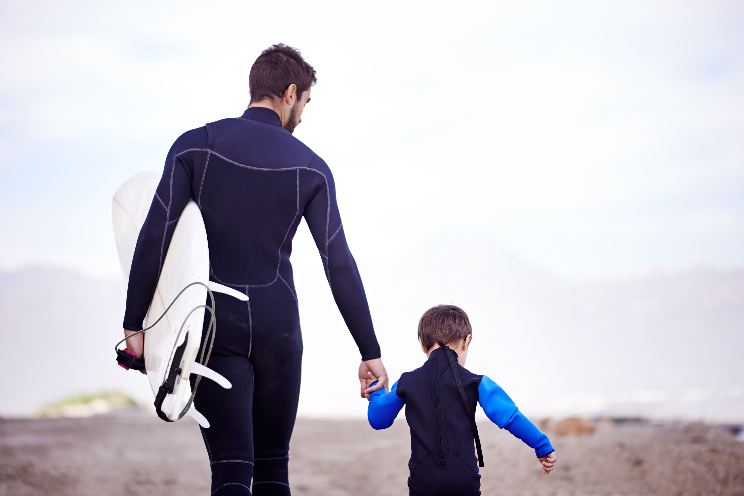

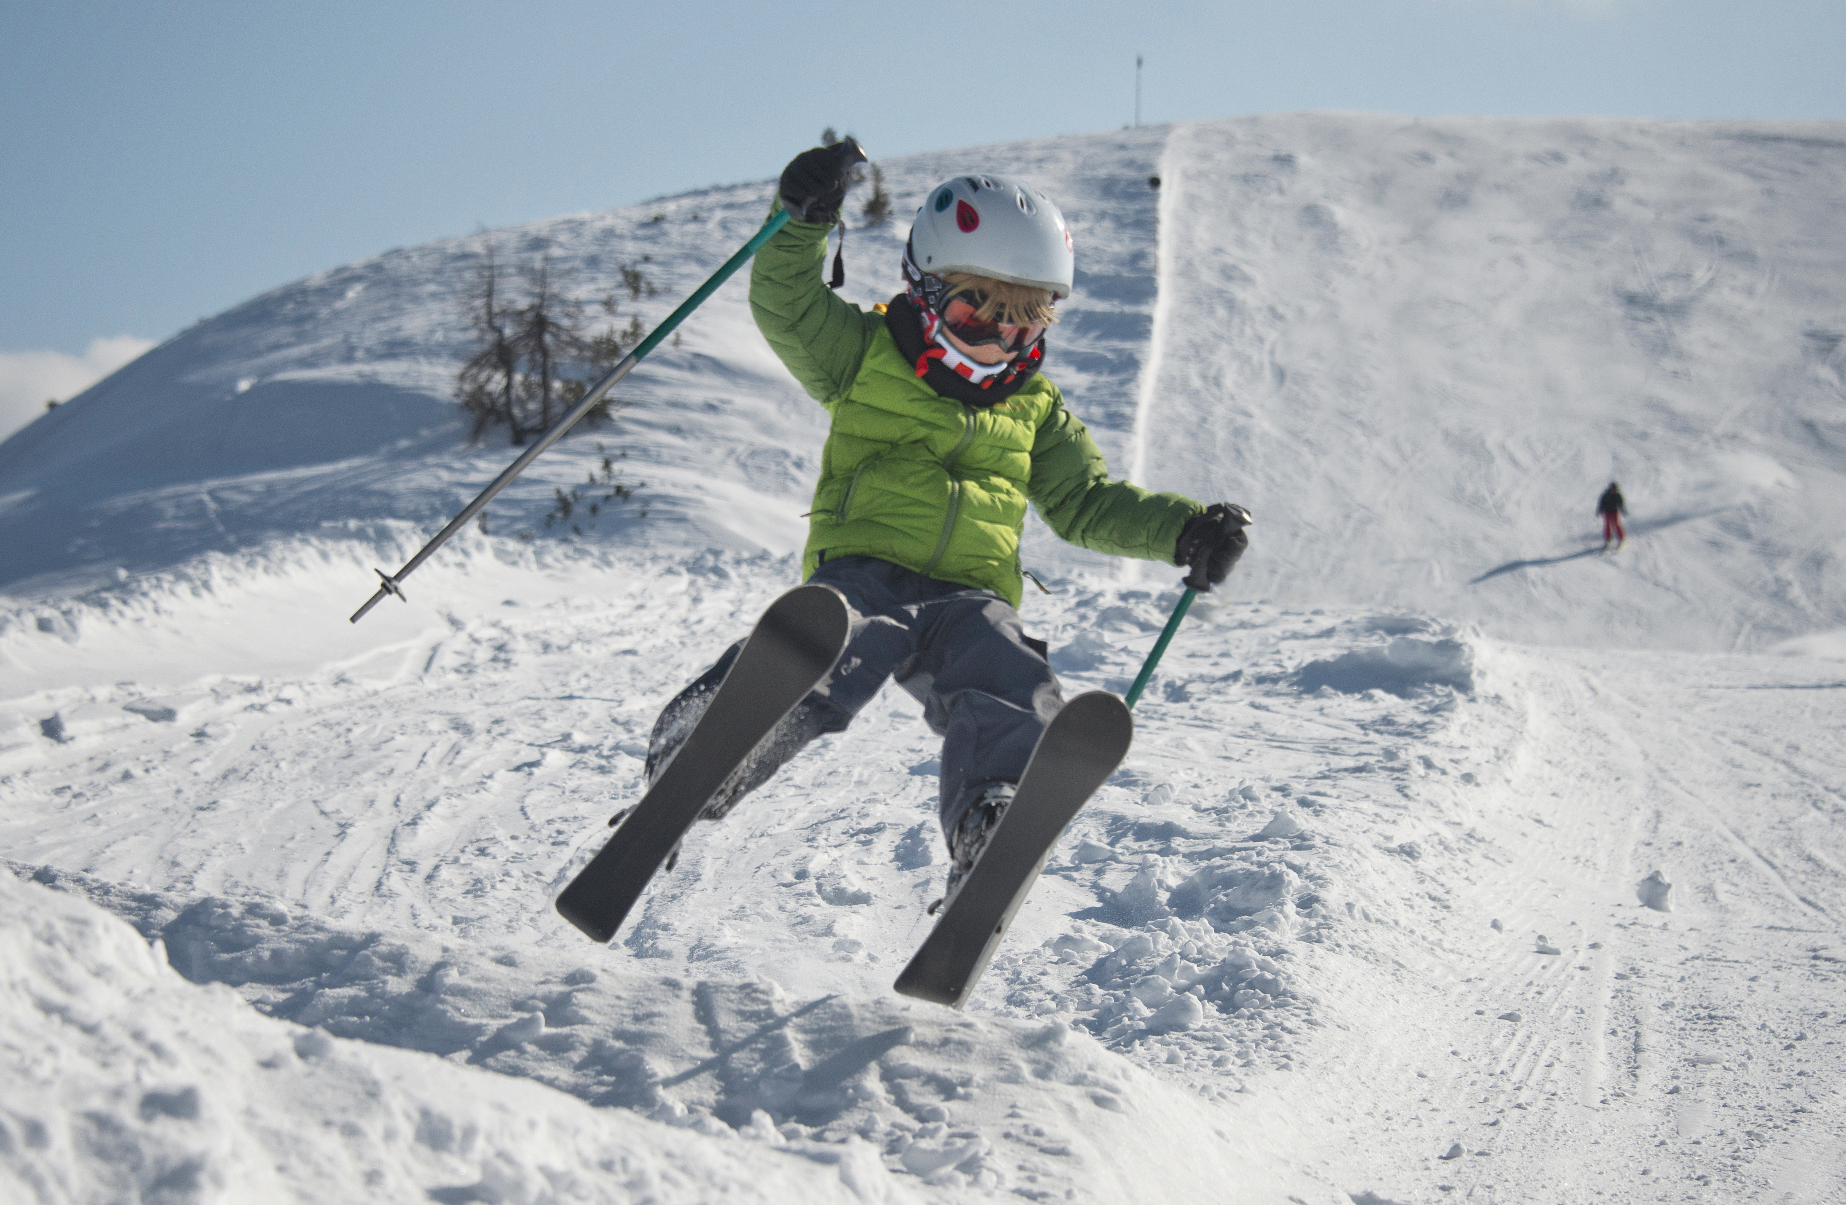
Seasonal Migration...
People moving to a location with each season for climate or jobs.

Slide 12
Seasonal Migration
In the 1830s General…Wade Hampton II purchased property in western North Carolina. “Like many…his family came to escape the hot summers and enjoyed fishing in the crystal-clear mountain streams, riding horses through lush green forests and sitting on the porch of Hampton Cottage sipping mint juleps and feasting on freshly cooked mountain fare.”
Turn and Talk to a partner about how is this an example of Seasonal Migration.
Whisnant and Whisnant. Black Lives and Whitened Stories. NPS. Carl Sandburg Home NHS. 2020 Pg. 209.
Notes:
**(Whisnant & Whisnant, 2020)

Slide 13
Let’s review our vocabulary by using...

Slide 14
Mix, Freeze, Group
Teacher will handout vocabulary word and definition cards.
While music is playing, students will walk around the classroom exchanging (mixing) cards.
Students will freeze when the teacher stops the music.
Students will group the vocabulary word with the correct definition.
Repeat until all students have had a turn to share.

Slide 15
Summarizing Strategy
3 - 2- 1 Exit Ticket
Write:
3 - Types of human migration
2 - Examples of one of the types of human migration
1 - Definition of one of the types of human migration

